Slide 1
STAMFORD UNIVERSITY BANGLADESH
Final Project Report On Scientific Calculator
By
Name: Ananda Chandra Mondal
ID: CSE066 07813
Or
Name: Nur Mohammad
ID: CSE067 07908
Supervised By
Dr. Tauhid Bin Iqbal

Slide 2
Abstruct
A scientific calculator is a type of electronic calculator, usually but now always handheld, designed to calculate problems in science, engineering, and mathematics. They have completely replaced slide rules in traditional applications, and are widely used in both education and professional settings.In certain contexts such as higher education, scientific calculators have been superseded by graphing calculators, which offer a superset of digital calculator functionality along with the ability to graph input data and write and store programs for the device. There is also some overlap with the financial calculator market.

Slide 3
TABLE OF CONTENTS
ABSTRACT………………………………………………….2
1. INTRODUCTION………………………………………4
2. DESCRIPTION………………………………………….5
a. System Requirements………………5
b. Basic Function………………………….6
3. Screenshots…………………………………………….8
4. Code Properties……………………………………10
5. Flowchart………………….………………………..17
6. Conclusion (Limitations and future work)..18

Slide 4
INTRODUCTION
The calculator was written by Rolf Howarth in early 1996. A fully featured scientific calculator with proper operator precedence is implemented, including trig functions and logarithms, factorials, 12 levels of parentheses, logs to base 2 (a handy function for information entropists!), bitwise logical operators, hex, octal, binary and ASCII display. The calculator is written in Java language and you are welcome to view the Java language source for personal educational purposes as long as you recognize that it is copyrighted and not in the public domain.

Slide 5
DESCRIPTION
Before developing software we keep following things in mind that we can develop powerful and quality software
PROBLEM STATEMENT
Problem statement was to design a module:
Which is user friendly
Which will restrict the user from accessing other user’s data.
Which will help user in viewing his data and privileges.
Which will help the administrator to handle all the changes.
FUNCTIONS TO BE PROVIDED:
The system will be user friendly and completely menu driven so that the users shall have no problem in using all options.
The system will be efficient and fast in response.
The system will be customized according to needs.
SYSTEM REQUIRMENTS
Operating system: MS Windows XP or Windows 10
Language: JAVA Language
Processor: Pentium IV Processor RAM: 512 MB Hard disk: 2 GB

Slide 6
BASIC FUNCTIONS
Addition
The addition (sum function) is used by clicking on the "+" button or using the keyboard. The function results in a+b.
Subtraction
The subtraction (minus function) is used by clicking on the "-" button or using the keyboard. The function results in a-b.
Multiplication
The multiplication (times function) is used by clicking on the "x" button or using the keyboard "*" key. The function results in a*b.
Division
The division (divide function) is used by clicking on the "/" button or using the keyboard "/" key. The function results in a/b.
Sign
The sign key (negative key) is used by clicking on the "(-)" button. The function results in -1*x.
Square
The square function is used by clicking on the "x^2" button or type "^2". The function results in x*x.

Slide 7
Square Root
The square root function is used by clicking on the "x" button or type "sqrt()". This function represents x^.5 where the result squared is equal to x.
Raise to the Power
The raise to the power (y raised to the x function) is used by clicking on the "y^x" button or type "^".
Logarithm
The logarithm (LOG) is used by clicking on the "LOG" button or type "LOG()".
Inverse
Multiplicative inverse (reciprocal function) is used by pressing the "1/x" button or typing "inv()". This function is the same as x^-1 or dividing 1 by the number.
Factorial
The Factorial function is used by clicking the "!" button or type "!".
PI
PI is a mathematical constant of the ratio of a circle's circumference to its diameter.

Slide 8
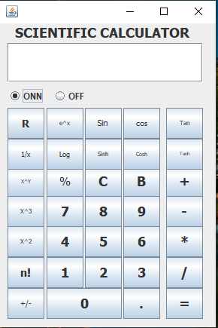
SCREENSHOTS

Slide 9
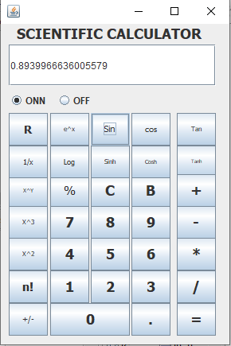

Slide 10
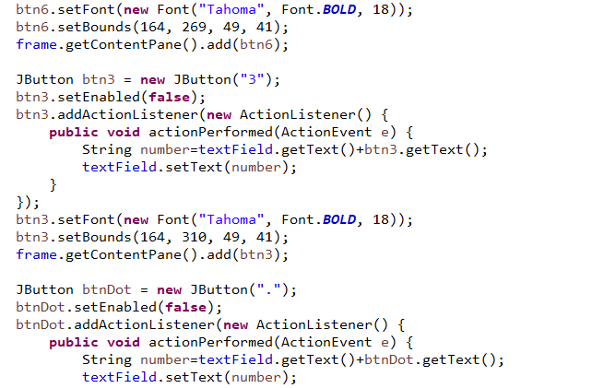
Code Properties

Slide 11
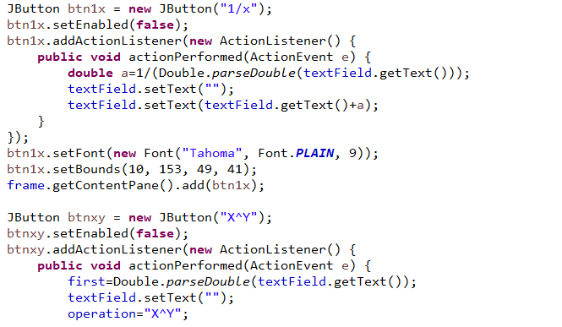

Slide 12
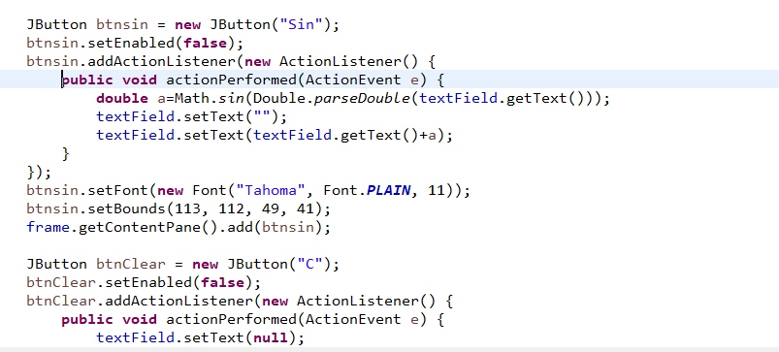

Slide 13
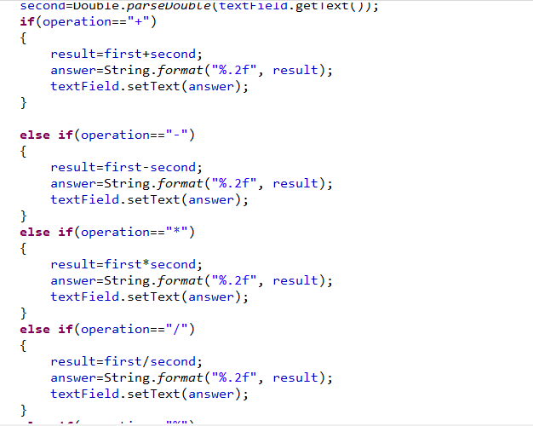

Slide 14
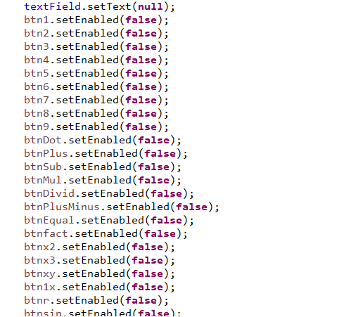

Slide 15
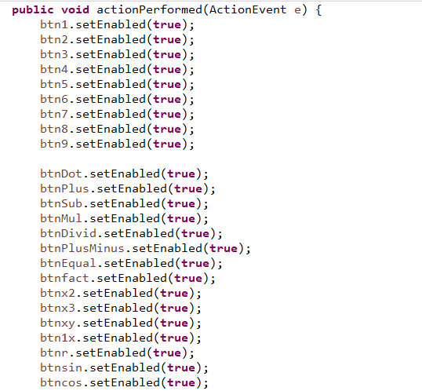

Slide 16
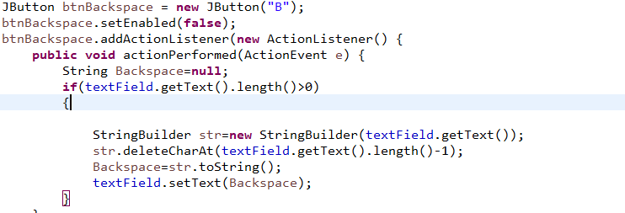

Slide 17
FLOWCHART
Do your any task
Trignometry (sin,cos) inverse (1/x)
yes
Start
Welcome to main menu
Enter your choice
On calculator
Do you want to continue
Stop

Slide 18
CONCLUSION(LIMITIONS AND FUTURE WORK)
LIMITATIONS:
This software has limited functionality like
Single user.
Cannot be implemented on networks.
FUTURE WORK:
This software has lots of future scope like
Multi user.
Implementation on network.
Screen share with their classmates.
Store history like if anybody want previous calculations.

